Slide 1
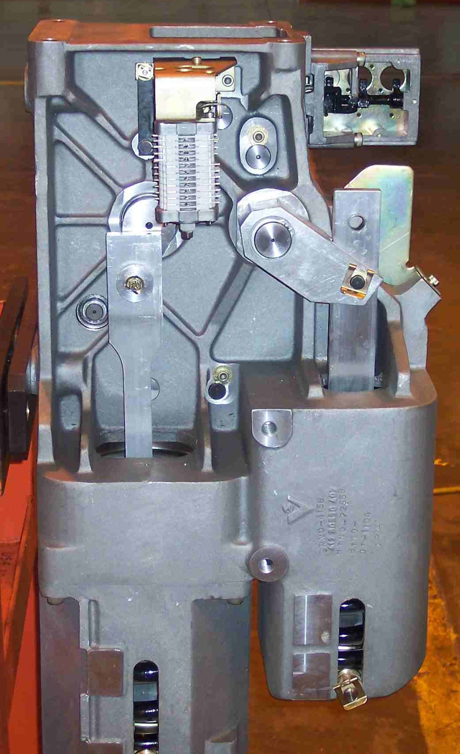
SIEMENS
HVCB SPARES
Drive Mechanism
72.5KA, 40KA, 145KV CB
S4711303763
Drive Mechanism
245KV CB
S4711303767

